Slide 1

Global Integration Bootcamp 2018

Slide 2
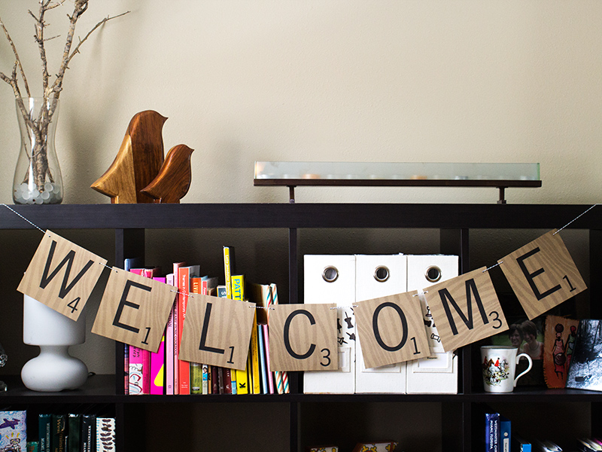

Slide 3


Slide 4
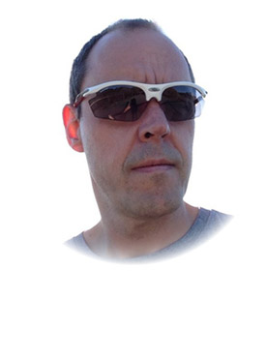
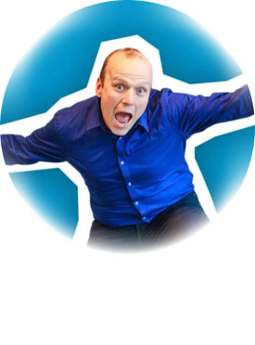
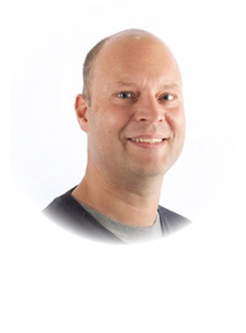
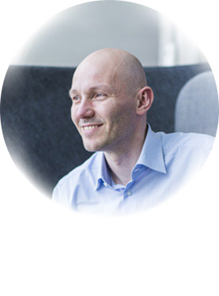
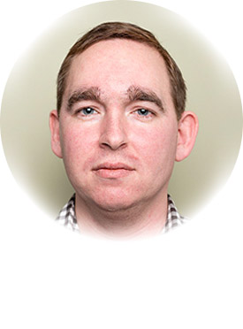
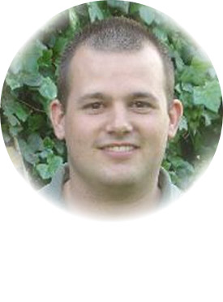
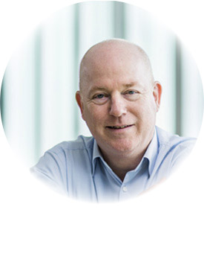
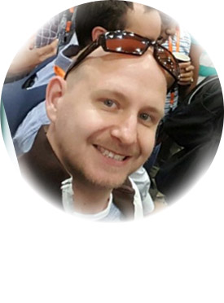
Global Organizers
Martin Abbott
Glenn Colpaert
Steef-Jan Wiggers
Tomasso Groenendijk
Eldert Grootenboer
Sven Van den brande
Gijs in ‘t Veld
Rob Fox

Slide 5
Our Crew
Abhishek Kumar (Datacom)
Alessandro Moura (Theta)
Craig Haiden (Datacom)
Desiree Suligan (Datacom)
Grant Harmer (Digging Dog)
Harris Kristanto (Adaptiv)
James Corbould (Datacom)
Mahindra Morar (Datacom)
Morten Velling (Datacom)
Nikolai Blackie (Adaptiv)
Wagner Silveira (Theta)

Slide 6
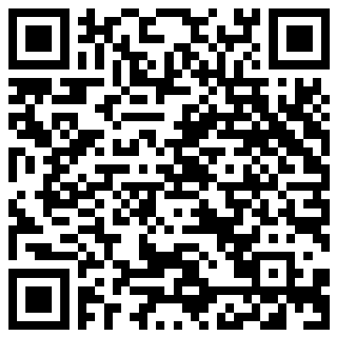
Labs
https://github.com/GlobalIntegrationBootcamp/GlobalIntegrationBootcamp/tree/master/2018/Labs

Slide 7
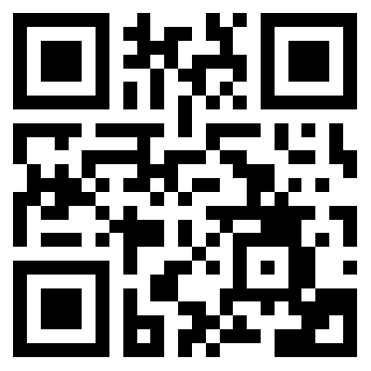
Please fill out the survey!
http://bit.ly/2ptjRdL

Slide 8





dcom_guest
#gib2018
#gib2018akl

